Slide 1
3MTT CAPSTONE PROJECT ON COVID-19
BY
Azeez Olabode Adewale
FE/23/30744857
COHORT 2

Slide 2
INTRODUCTION
objective
Data collection
The objective is to explore the data, developed predictive models and provide insight of the spread of Covid-19
The dataset was sourced from Kaggle

Slide 3
DATA PREPROCESSING
I imported the necessary libraries for the analysis, then loading the data from the file and examining the dataset. This allows me to determine the necessary cleaning steps and identify column needed for my analysis.
PRE-VIEWING THE DATA
The dataset consists of 187 entries and 15 columns, capturing various Covid-19 metrics for different countries and regions. The summary of the column is listed below.
Country/Region: The country or region name
Confirm, Deaths Recovered, and Active: Case count by status
New Cases, New deaths, New recovered: Recent case changes
Deaths/100 Cases, Recovered/100 Cases, Death /100 Recovered: Ratio per percentage
Confirmed last week, 1 week change, 1 week % increase: Weekly case changes
WHO Region: Assigned region
From the data, there are no missing values

Slide 4
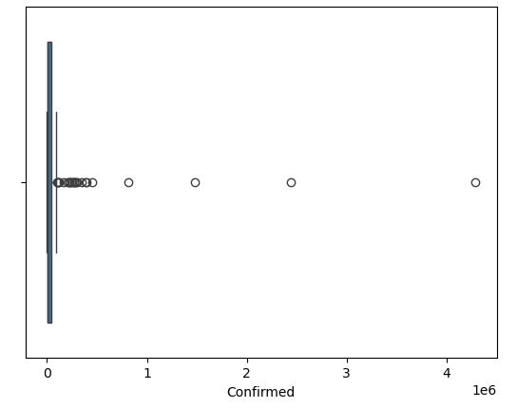
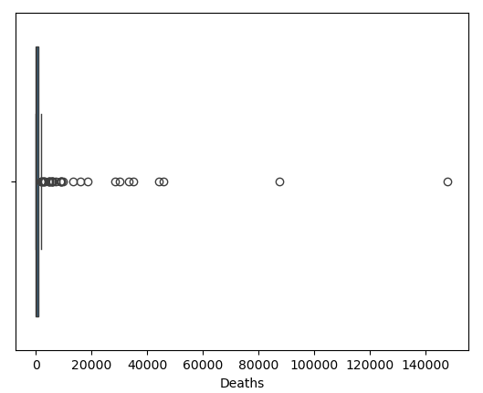
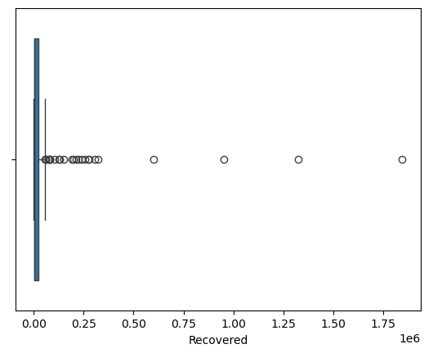
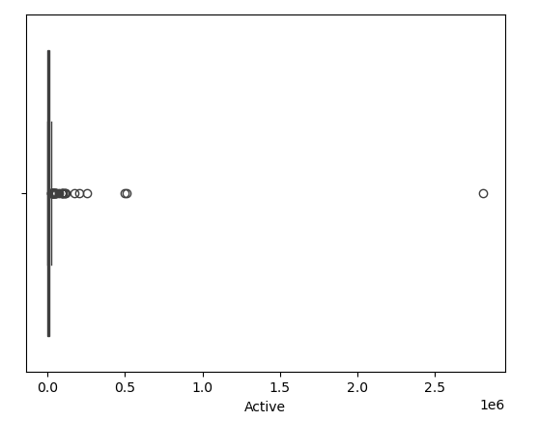
EXPLORATORY DATA ANALYSIS
Visualization of Univariate Analysis
Confirmed Cases of Covid-19
Deaths Cases of Covid-19
Recovered Cases of Covid-19
Active Cases of Covid-19

Slide 5
Insights of the above Visualization
Boxplot shows the distribution of the cases of Covid-19. There is a noticeable spread with the data with outliers
Confirmed Cases and Deaths Distribution are rightly-skilled which indicate a few countries have high count compared with the majority
Recovered and Active cases follow a similar distribution pattern.

Slide 6
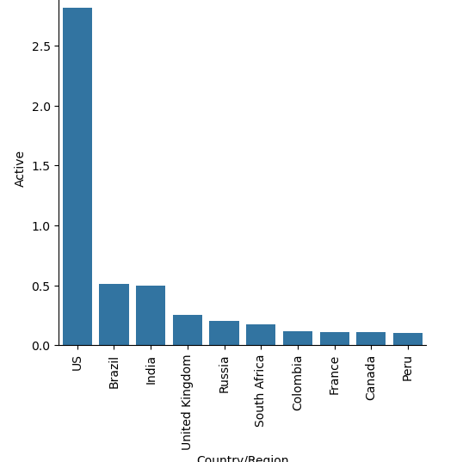
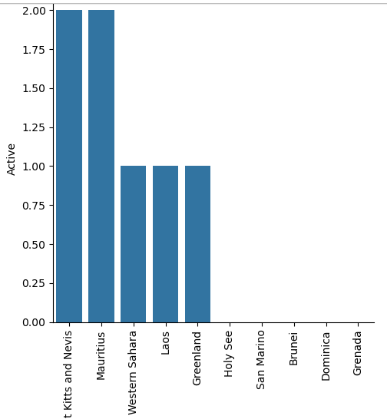
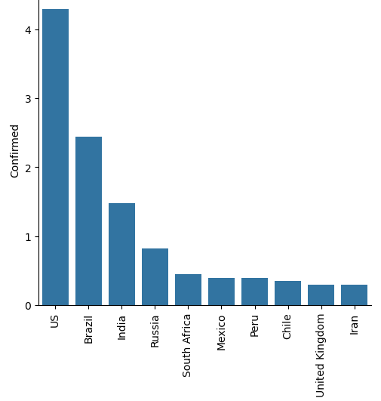
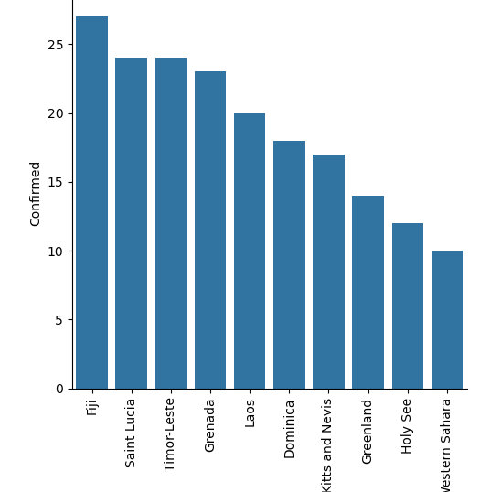
Multivariate Analysis
Active Cases By Country of Covid-19
Confirmed Cases By Country of Covid-19
Few countries show significantly higher active cases but US has the highest number of active cases of Covid-19 while Saints Kitts, Mauritius, Western Sahara have relatively low active cases with Holy See, Sam Marino, Brunei, Domica and Grenada have no active cases
US has the highest number follow by Brazil, India, Russia while Greenland, Holy Sea and Western Sahara reported least number of confirmed cases.

Slide 7
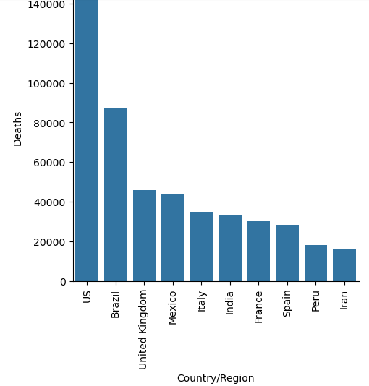
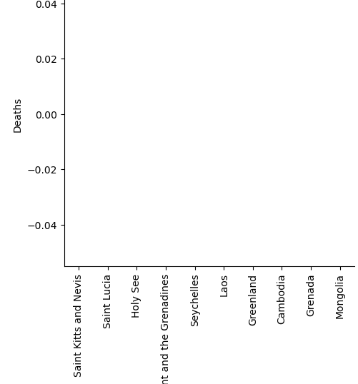
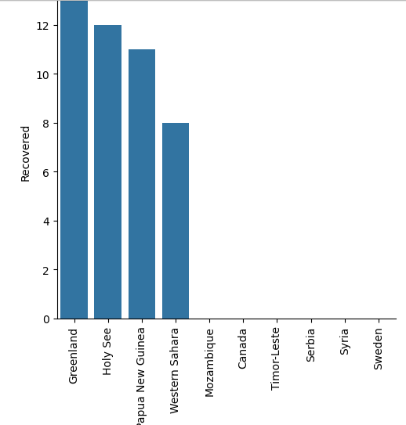
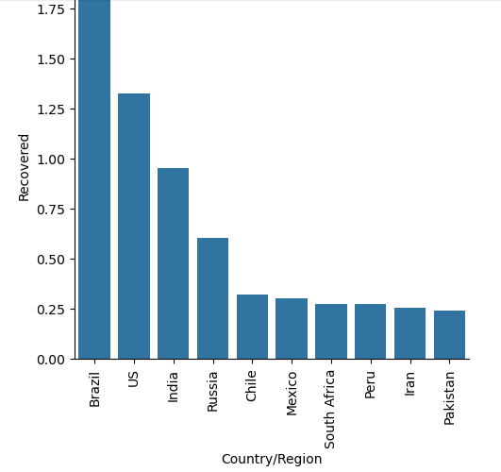
Multivariate Analysis
Deaths Cases By Country of Covid-19
Recovered Cases By Country of Covid-19
US recorded the highest number, followed by Brazil, United Kingdom, Mexico, Italy, Indian, France and Spain with high cases of death while Seychelles, Laos and others recorded no cases of death.
Brazil, US, India and Russia recorded the highest cases with Greenland Holy See, Papua New Guinea recorded least cases while Mozambique, Canada, Sweden and others recorded no cases.
.

Slide 8
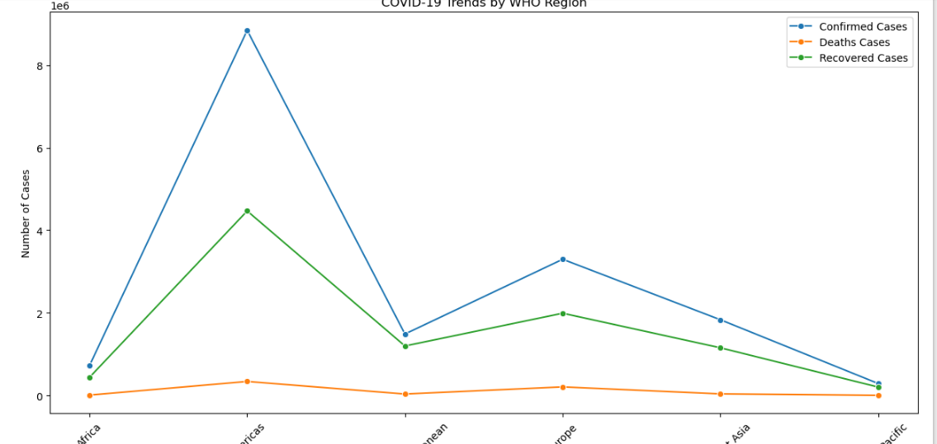
COVID-19 Trends By WHO Region
The visualization shows which region were most affected by Covid-19. Americas recorded highest number of Confirmed and Death Cases while Africa and Western Pacific have relatively Low Confirmed and Death cases

Slide 9
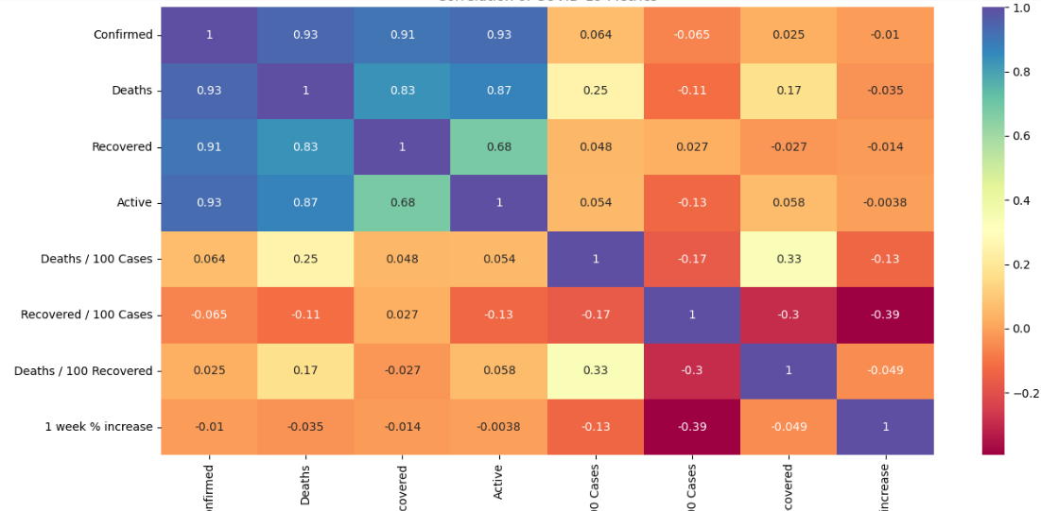
Correlation of COVID-19 Metrics
Strong positive correlation exists between confirmed and death (0.93), recovered (0.91) and active (0.93)
New cases are confirmed 0.91 and new death (0.97)
Percentages increase in cases and death shows weak correlation with the total count suggesting other factor may influence weekly growth rate

Slide 10
MODEL DEVELOPMENT
Machine Learning Model
Model Selection
Linear regression model was trained for predicting active cases based on other feature such as confirmed, death recovered new cases, new death and new recovered. The features were selected because they correlate with active cases.
Model Training
The linear regression model was trained to learn the relationship between the features and the number of active cases
Trained-test Split
80% was used to train while 20% to test.

Slide 11
MODEL DEVELOPMENT(CONTD.)
Model Evaluation
Coefficient and Intercept
The model performance was evaluated using Root Mean Square Error (RMSE) and R-Square.
The RMSE shows the average difference between predicted and active cases meaning that a lower RMSE indicates better performance.
Also the R-square shows how well the model explain the variance in the data with value closer to 1 indicating a better fit
From the Model, RMSE is approximately 2.70 e⁻¹¹ which means the model is performing well.
R-Square is equal to 1 which means a better fit i.e the model is performing 100% which could be due to data leakage.
The linear regression model provides coefficient for each feature, the expected changes in active cases for a 1 unit change in the feature if other features are kept constant.
From the coefficient, it can be deduced that
Confirmed cases, Deaths and Recovered are the major features contributing to the active cases of Covid-19
New cases, new death and new recovered have no or little influence on active cases of Covid-19

Slide 12
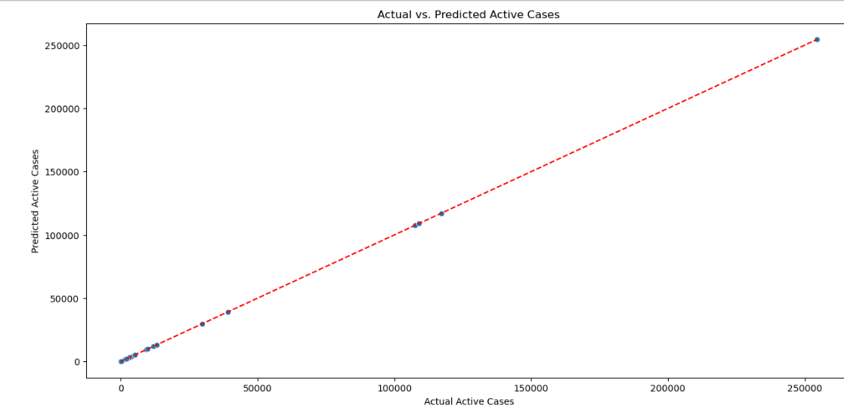
MODEL PERFORMANCE VISUALIZATION
This shows the performance of the model
The points are closer to the diagonal line which shows that the model prediction align with the actual value

Slide 13
CONCLUSION
The predictive model provides actionable insight for managing active Covid-19 cases effectively by implementing timely in regions at the risk of becoming overwhelmed by high active case count.
This model helps in understanding the factor that influence active cases and this can be used to forecast active cases based on current data, for instance knowing how confirmed cases and recovered and death impact active cases allows health organizations to prepare resources based on anticipated active cases supporting effective resources planning

